Slide 1
Project: rdt
11811713 鲁昊天 11811636 曾鸣 11813010 杨睦圳
Notes:
使用Transfer learning构建一个基于雷达信号的动作识别系统

Slide 2
Division of labor
11811713 鲁昊天
Data transmission and retransmission
11811636 曾鸣
Connection establishment and maintaining
11813010 杨睦圳
Congestion control and test

Slide 3
Message format
FLAG | SEQ | SEQACK | LEN | TIME | CHECKSUM | PAYLOAD
1 Byte | 4 Bytes | 4 Bytes | 2 Bytes | 7 Bytes | 2 Bytes | LEN Bytes
Receive Data Buffer
HEADER (20 Bytes) + PAYLOAD (LEN Bytes)
Flag (1 Byte): ACK, SYN, FIN, END
TIME (7 Bytes): Time when the datagram is send

Slide 4
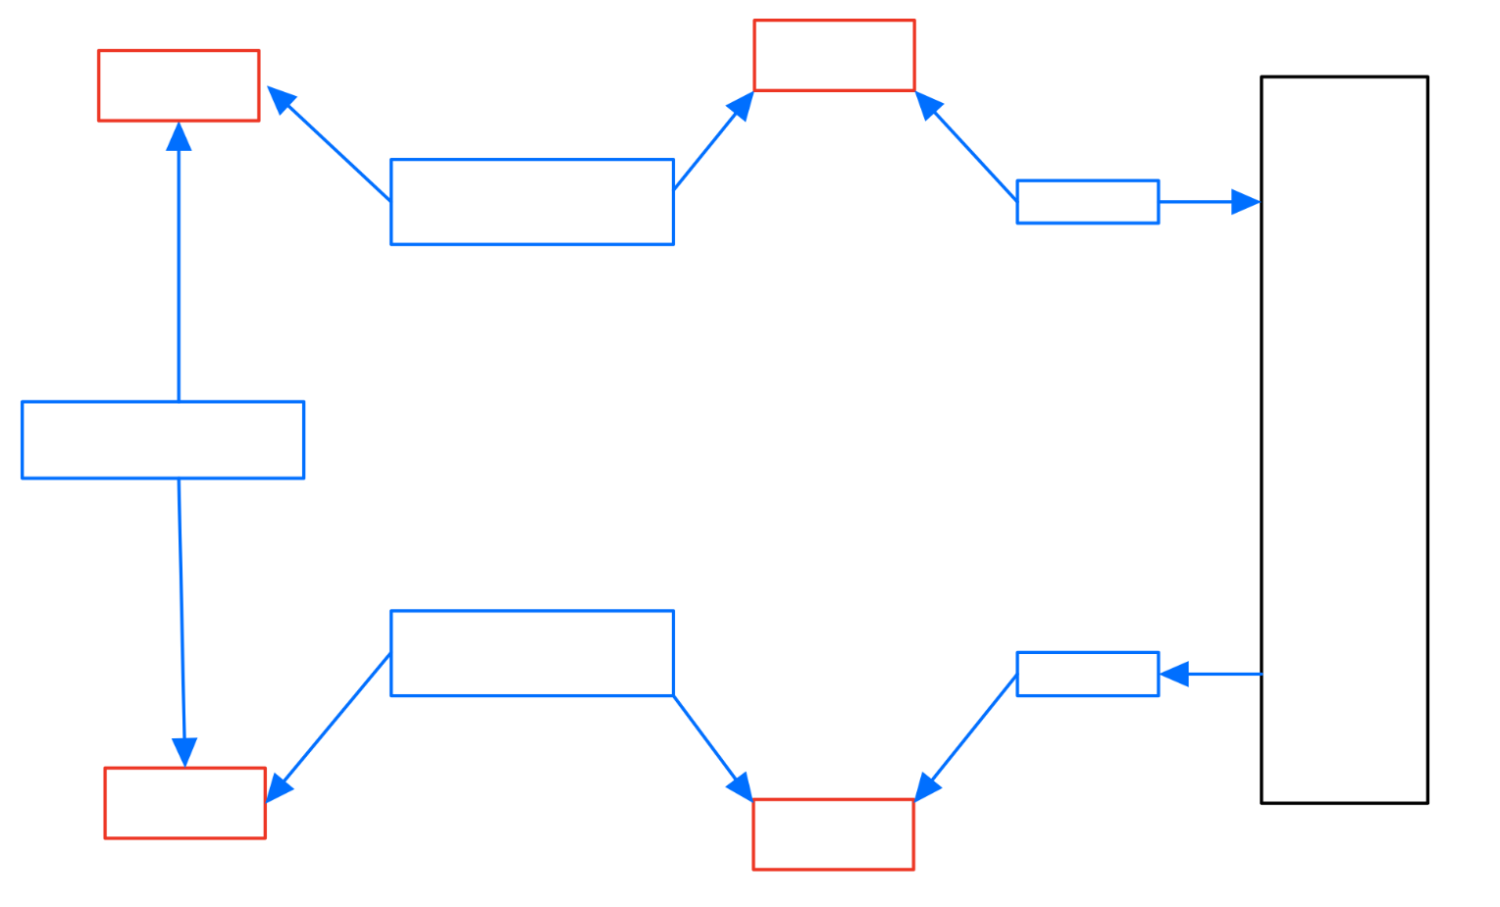
Structure design
Transmit_queue
Send_queue
Four main threads for each socket:
Send thread
Listen Send_queue
Send the data to the network
Receive thread
Listen the network
Put the received data into Receive_queue
Transmit thread
Listen to Transmit_queue
Generate the datagram
Control the send rate
Set the timer, …
Process thread
Extract the received data
Update the connection state: seq, seqack, …
Transmit Thread
Send Thread
send()
NETWORK
Main Thread
Process Thread
Receive Thread
recv()
Receive Data Buffer
Receive_queue

Slide 5
Reliable data transfer
The method used in the program is based on TCP
Accept and establish a connection
Maintain the connection, keep listening and replying
Close the connection, release the resources
Mechanism of rdt:
cumulative ACKs
a timer for each datagram waiting for ack
retransmissions triggered by:
timeouts
duplicate ACKs

Slide 6
Round trip time
We roughly estimate the RTT of one datagram as 2 * (receive_time – send_time)
To set the timeout, we use Jacobson / Karels Algorithm:
SRTT = SRTT + α * ( RTT – SRTT )
DevRTT = (1 – β) * DevRTT + β * |RTT - SRTT|
RTO = μ * SRTT + ∂ *DevRTT (time to be set as timeout)
In our program, we take α = 0.125，β = 0.25， μ = 1，∂ = 4

Slide 7
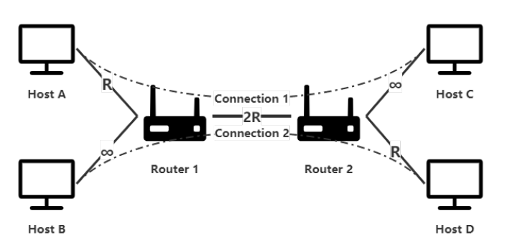
Congestion
The main refactor affects throughput efficiency in the above network is the congestion
The network will collapse if congestion occurs and the retransmission is not dealt correctly
Congestion control should be able to make the connections fairly share the resource

Slide 8
Congestion control
Duplicate ACK: Receive the same SEQACK for more than (window_size / 2 ) times
Reduce the window size by 20%
Time out:
For the first time, reduce the window size by 1 / 3 * window_size
For the second time, reduce the window size by 1 / 2 * window_size
(1 / 3 of the window size before the first reduction)
For more time out, keep window size to be 1
Increase the window:
When a datagram is transmitted successfully, increase the window by min( 0.2, 2 / window_size)

Slide 9
evaluation
 | 0, 50kB | 0, 10kB | 0, 3kB | 0.1, 100kB | 0.1, 10kB | 0.1, 5kB
Single Connection | 83.18% | 74.17% | 51.15% | 52.25% | 50.96% | 48.34%
Double Connection

